Slide 1
Week2 tutorial for MAT2041

Slide 2
Exercise 1
What is the coefficient matrix?
What is the augmented matrix?

Slide 4
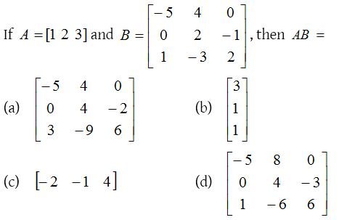
Exercise 3

Slide 5
Exercise 4
1. Compute (AB)C and A(BC)

Slide 6
Acknowledgements
These slides is based on previous tutorial materials of MAT2041. We thank previous TAs and instructors for sharing previous course materials.

