Slide 1
Welcome to the tutorial session of week3 ！！！

Slide 2
In this tutorial session,
we will focus on:
Partitioned product
Matrix-matrix product
Gaussian Elimination
Elementary Matrix

Slide 3
Recall (Partition)
Two rules:
1. Blocks’ dimensions match
2. Components’ dimensions match

Slide 4
Exercise 1

Slide 5
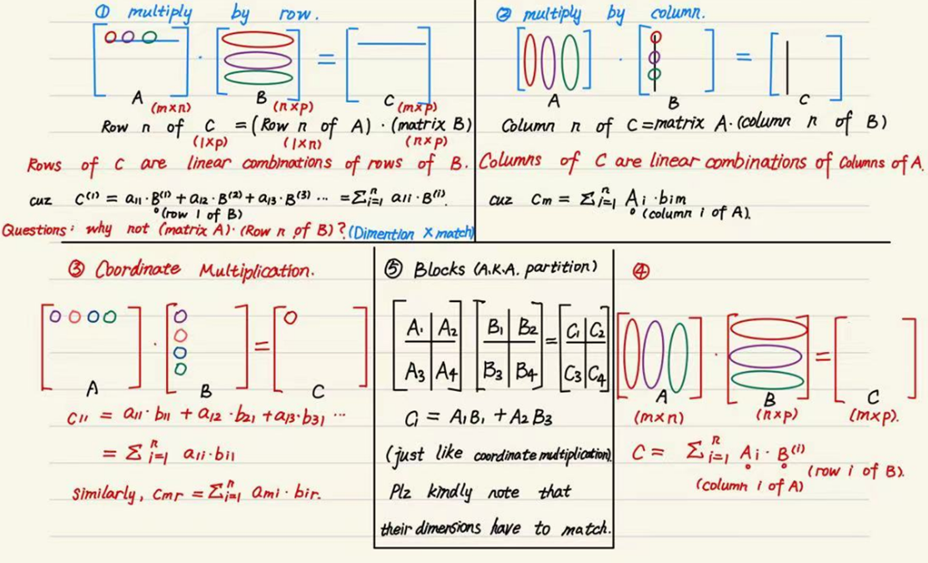
Recall (Matrix multiplication)

Slide 6
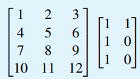
Compute the following matrix multiplication by utilizing given method:
Multiply by row (Row-form * Matrix)
Multiply by column (Matrix * Column form)
Coordinate multiplication
Column * Row

Slide 7
Recollection (what is elementary matrix?)

Slide 8
Exercise 3
（a）Transform the linear system below into an augmented matrix and then use Gaussian Elimination to convert it to the desired form.
（b) Figure out the elementary matrices related to corresponding elementary row operations.

Slide 9
Exercise 4

Slide 10
Exercise 5
Verify: the product of two upper triangular matrices is still upper triangular (prove it using 2x2 block matrix multiplication rather than the usual matrix multiplication)

Slide 11
Acknowledgements
These slides is based on previous tutorial materials of MAT2041. We thank previous TAs and instructors for sharing previous course materials.

