Slide 1
Week4 tutorial for MAT2041

Slide 2
Exercise 1

Slide 4
Exercise 3

Slide 5
Exercise 4

Slide 6
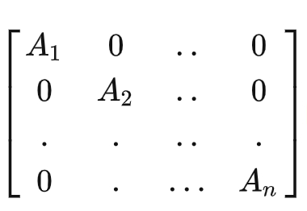
Exercise 5
Find the inverse of the following matrix.
Block Diagonal Matrix Block Upper Triangular matrix

Slide 7
Exercise 6

Slide 8
Acknowledgements
These slides is based on previous tutorial materials of MAT2041. We thank previous TAs and instructors for sharing previous course materials.

