Slide 1
Welcome to the tutorial session of week5 ！！！

Slide 2
In this tutorial session,
we will focus on:
Solving square linear system
Inverse

Slide 3
Recall (Partition)
How to solve a square linear system?
1. Transform the linear system to an augmented matrix
2. Gaussian Elimination
3. Write down the solution set

Slide 4
Exercise 1 （n pivots case）

Slide 5
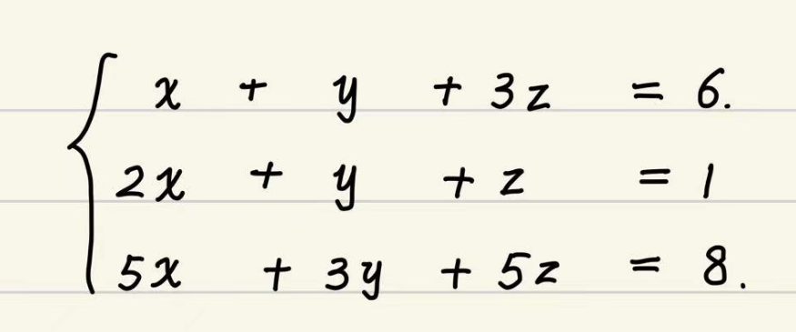
Exercise 2 （less than n pivots case）
Solve the following linear system.

Slide 6
Recall (Inverse)
What is the rigorous definition of inverse?

Slide 7
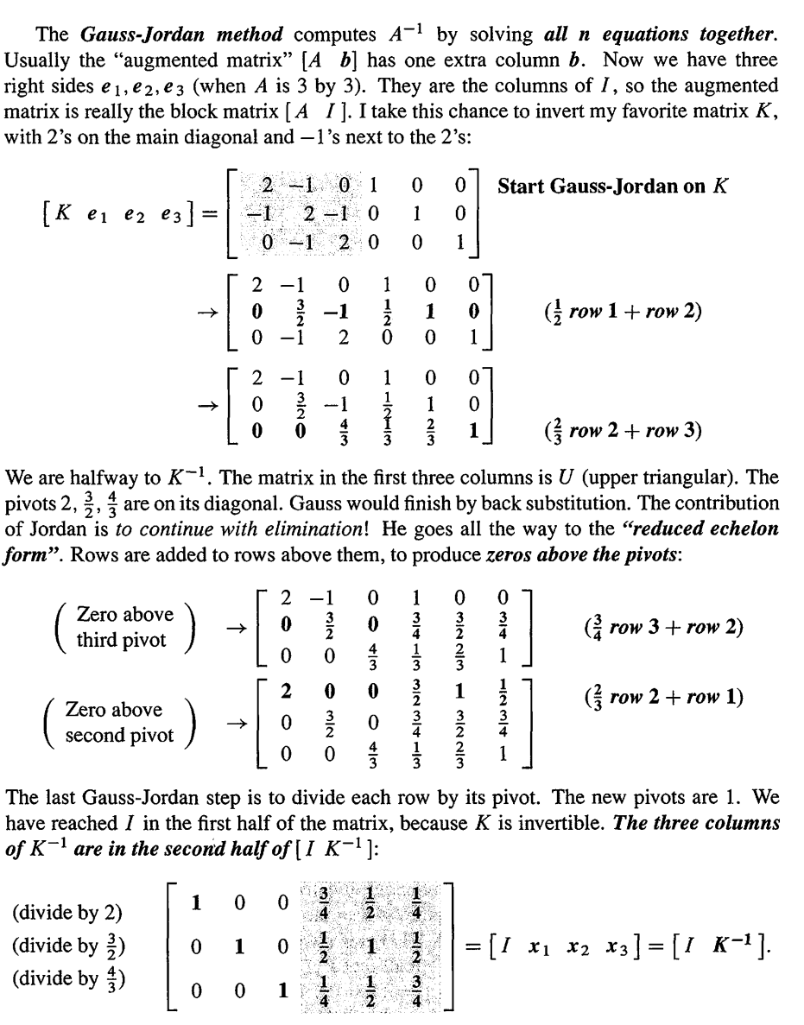
Recall (Inverse)
How to find the inverse
of a specific square matrix?
In short：

Slide 8
Exercise 3
Find the inverse of the following matrix.

Slide 9
Exercise 4
prove that
If A is invertible, then
Gauss-Jordan elimination produces n pivots.
(note that row exchanges are allowed)

Slide 10
Acknowledgements
These slides is based on previous tutorial materials of MAT2041. We thank previous TAs and instructors for sharing previous course materials.

