Slide 1
Welcome to the tutorial session of week9 ！！！

Slide 2
In this tutorial session,
we will focus on:
Orthonormal basis & Orthogonal Matrix
Gram-Schmidt Process
Determinant
Mid-term

Slide 3
Brief review for Least square problem please meticulously read it if the least square problem is still challenging for you because it takes me more than 1 hour to type it while compressing all the content to a single page and establishing the connection with the previous content.
Step 1: transformation
min ∥ Ax − b ∥² ⟺ min ∥Ax − b ∥ ⟺ ∥ Ay − b ∥ ≤ ∥ Ax − b ∥ for any x
(please kindly notice that y is the x that can minimize ∥Ax − b ∥ )
Step 2: apply orthogonal projection theorem
∥ Ay − b ∥ ≤ ∥ Ax − b ∥ for Ax ∈ C(A) ⟺ Ay − b ⊥ C(A)
(Remark 1: the arbitrariness of x gives rise to the random selection of Ax in C(A))
(Remark 2: If you are still confused about it, please go to the previous lecture notes.)
Step 3: utilize space knowledge
Ay − b ⊥ C(A) ⟺ Ay – b is in the left null space of A (N(A^{T} )) ⟺ A^{T}(Ay − b ) = 0
（Gloss ：why? Because the left null space of A (N(A^{T} )) (A.K.A. the null space of (A^{T}))
is the orthogonality complement of the Column space of A (C(A)) )
Conclusion:
min ∥Ax − b ∥ ⟺ A^{T}Ay= A^{T}b

Slide 4
Orthonormal basis
Orthogonal set
Orthonormal set
Orthonormal basis

Slide 5
Orthogonal matrix
1. definition
2. Equivalent condition
Correlation between concepts:
Orthogonality → Orthogonal set → orthonormal set → orthonormal basis → orthogonal matrix

Slide 6
Orthogonal versus Orthonormal
Semantically,
Orthonormal = Orthogonal + normal
Set versus Basis
Similarly,
Basis =Set(all the elements within the sets belong to the space)
+ Span(all the elements within the set span the space)
+ Linear independence(all the elements within the set are LI)

Slide 7
Exercise 1
Please notice that the reflection matrix Q here is a special orthogonal matrix with
Q=Q^{T}=Q⁻¹

Slide 8
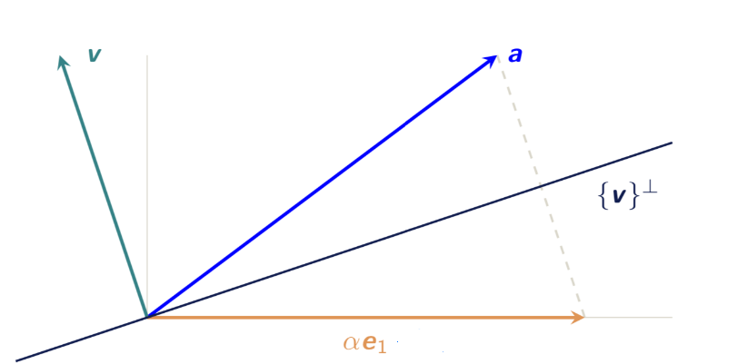
In case you are interested in the reflection matrix: (supplementary) (were you not interested in it, please skip it !)
Can be used to do elimination:
Ha = ||a||e₁(norm preserving)
Geometric interpretation:
How about the inverse and determinant
of the reflection matrix?
(hint: inverse(1.geometric meaning 2.the reflection
matrix is essentially a special orthogonal matrix)
determinant(start with simple examples))

Slide 9
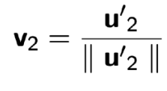
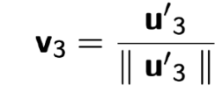
Gram-Schmidt Process
For what?
Find the orthogonal basis of span(S)
Key idea:
Induction
Process:
Vector 1 in S: calculate: ******** normalize:
Vector 2 in S: calculate: normalize:
Vector 3 in S: calculate: normalize:
Vector 4 in S: …….(So on and so forth.)
Eventually, the orthogonal basis of span(S) is {v₁, v₂, v₃,…}

Slide 10
What’s the correlation between Gram-Schmidt Process and Least square problem? (supplementary)
How do we essentially solve least square problem?
Project the vector b to a space spanned by all the
Possible Ax.
What’s the key idea in Gram-Schmidt Process?
Project the next vector to the subspace spanned by the
previous vectors which has an orthogonal basis
computed by previous Gram-Schmidt Process.

Slide 11
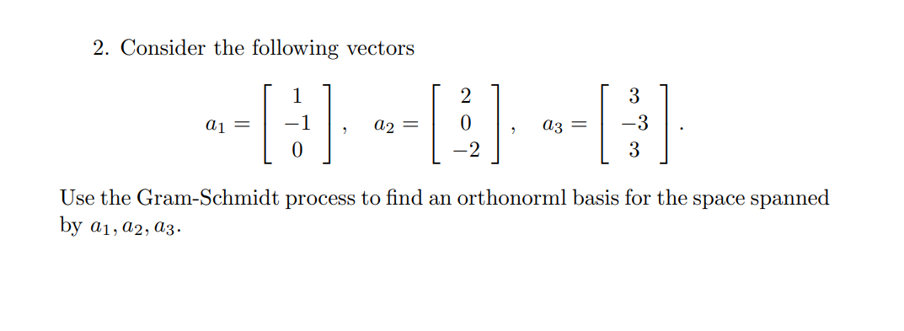
Exercise 2

Slide 12
Determinant
Please notice that this is a recursive definition!
Property: det(AB) = det(A) * det(B)

Slide 13
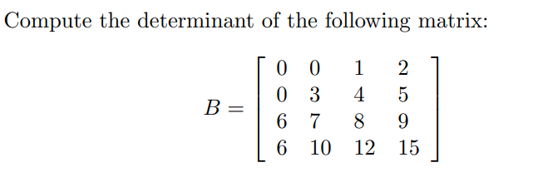
Exercise 3

Slide 14
Supplementary：
“龙生龙，凤生凤，华罗庚的学生会打洞。”
“打洞” here actually refers to “block elimination”
E.g.
During which, the rank and determinants for the matrix
would not be changed.
Therefore, “打洞” is a pretty powerful method to compute
determinants and simplify the problems!

Slide 15
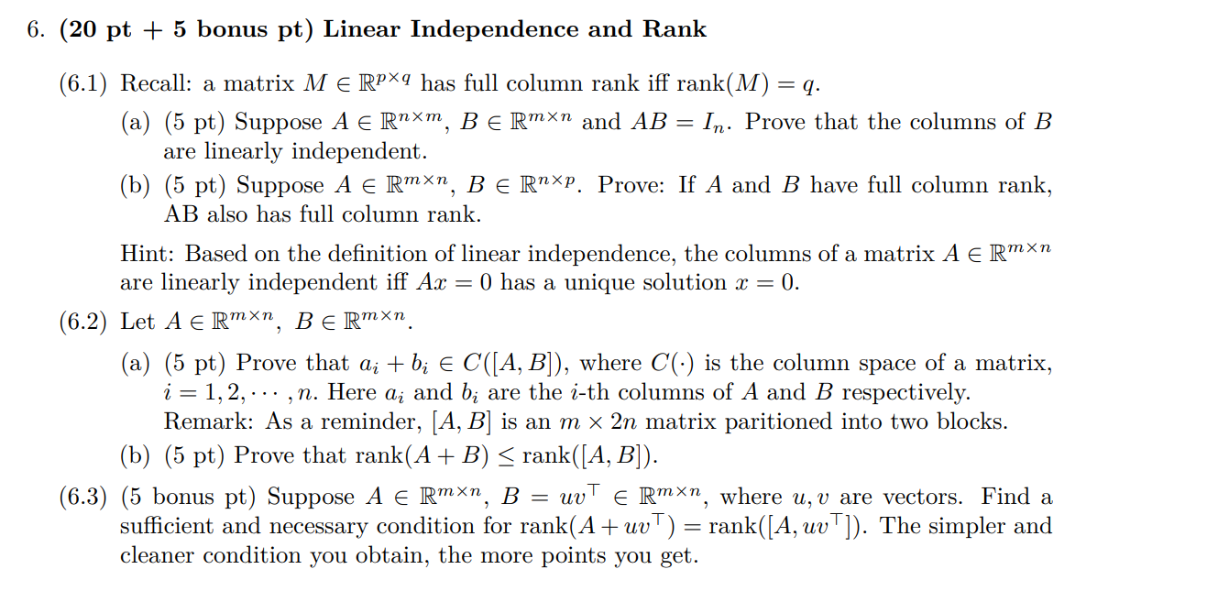
Revisit mid-term!
It’s pretty important to learn from your mistakes if there is any!

Slide 16
Congratulations to students who achieved good grades! Please keep up with the good work.
For those who did not perform well, please do not give up and take this as an opportunity to motivate yourself to think about learning methods and invest more time in studying. In the long journey of life, being able to improve oneself based on feedback is a very important skill.
That’s actually what my LA instructor told me, from which I benefit really a lot.

Slide 17
Acknowledgements
These slides is based on previous tutorial materials of MAT2041. We thank previous TAs and instructors for sharing previous course materials.

